Slide 1

ArcGIS Geoprocessing:
Python Scripting - Advanced Techniques
Ghislain Prince
Elizabeth Flanary

Slide 2
A little bit about us
  Product Engineers on GP development team
A little bit about you
  Already using python?
  Familiar with AML?
  Familiar with VB6 & ArcObjects?
  Which IDE do you use: pythonwin, IDLE, Wing, vi?
UC 2008 Tech Sessions

Slide 3
Workshop Outline
What’s new at 9.3
Cursors
  Reading and writing geometry
Creating and using objects for tool parameters
  Spatial Reference example
Effective error handling
Working with ArcGIS Server geoprocessing services
  Submitting jobs and getting results
UC 2008 Tech Sessions

Slide 4
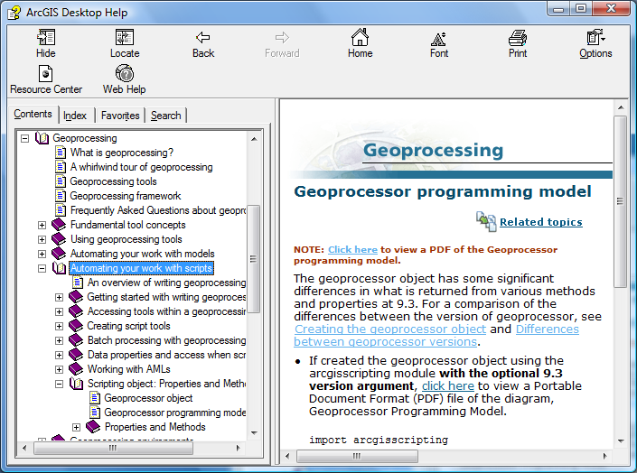
Documentation
References to help system throughout this tech workshop
UC 2008 Tech Sessions

Slide 5
Section 1:
What’s new at 9.3?
UC 2008 Tech Sessions

Slide 6

The geoprocessor
 | Pythonic | Cross-Platform | ArcGIS Version | Python Version
import arcgisscripting gp = arcgisscripting.create(9.3) |  |  | 9.3 | 2.5
import arcgisscripting gp = arcgisscripting.create() |  |  | 9.2 or 9.3 | 2.4 or 2.5
import win32com.client gp = win32com.client.Dispatch(“esri… |  |  | 9.0, 9.1, 9.2, 9.3 | Any
Scripts created at 9.0, 9.1 and 9.2 can be used as is.
In addition to Python, the dispatch object may be used in a variety of other scripting languages (Perl, VBScript, JScript)
UC 2008 Tech Sessions

Slide 7
The geoprocessor
Advantages of using a “9.3” geoprocessor …
Boolean properties are true Booleans (not strings or a 0 / 1)
List functions return Python lists (not enumerations)
All tools return a result object
Extent and point properties are returned as extent and point objects (not delimited strings)
Returns Unicode instead of strings (supports non-ASCII characters)
UC 2008 Tech Sessions

Slide 8
AddFieldDelimiters Method
The syntax used to build an SQL expression varies on the data source
The AddFieldDelimiters method removes the guess work in getting the appropriate field delimiters in your SQL expression
  crimeFC = “c:/data/crime.mdb/crime”
  # Use AddFieldDelimiters to add correct delimiters
  dField = gp.AddFieldDelimiters(crimeFC, “BEAT”)
  query = dField + “ = 1”
  gp.Select(crimeFC, “c:/data/crime.mdb/beat1”, query)
UC 2008 Tech Sessions

Slide 9
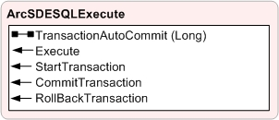
ArcSDESQLExecute Object
For users that are experienced using SQL against ArcSDE geodatabases and would like a more integrated approach to sending their SQL to the ArcSDE database
Supports most SQL statements
  DML – eg. SELECT, INSERT,
  UPDATE, DELETE
  DDL – eg. CREATE, DROP,
  ALTER
  SQL functions with ST_GEOMETRY spatial type for Oracle, DB2,
  Informix and PostgreSQL
  Oracle Spatial functions against SDO_GEOMETRY spatial type
UC 2008 Tech Sessions

Slide 10

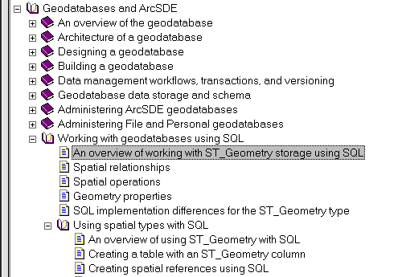
ArcSDESQLExecute Object
Very important to understand the impact of issuing SQL Statements against Geodatabase objects.
Please read the ArcGIS “Working with geodatabases using SQL” book for guidance.
UC 2008 Tech Sessions

Slide 11
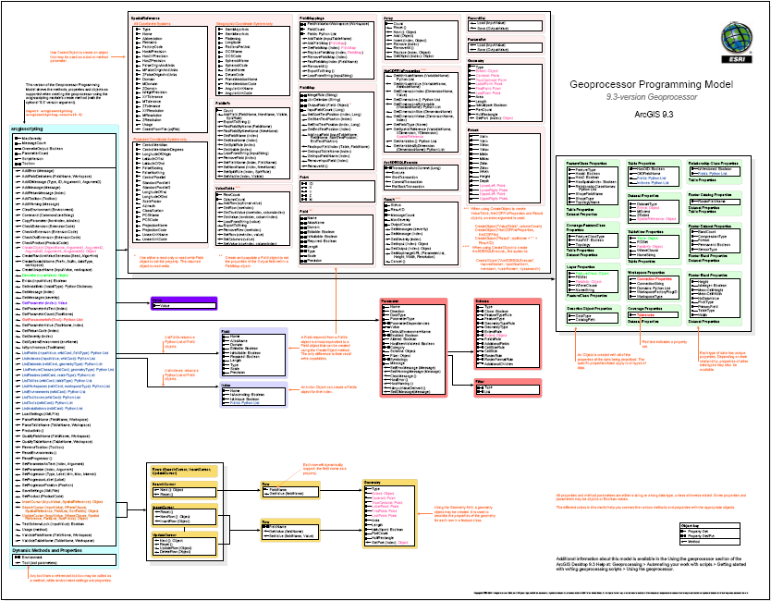
http://webhelp.esri.com/arcgisdesktop/9.3/pdf/Geoprocessor_93.pdf
UC 2008 Tech Sessions

Slide 12
Section 2:
Cursors
UC 2008 Tech Sessions

Slide 13
Accessing Data with Cursors
There are three types of cursors
 | Read Records | Modify Records | Add Records
Search Cursor
Update Cursor
Insert Cursor
UC 2008 Tech Sessions

Slide 14
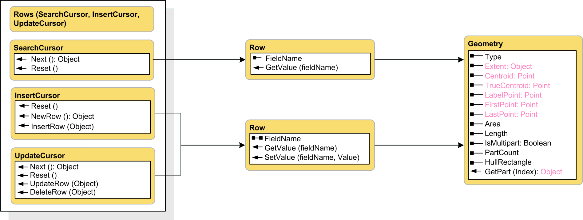
Reading Feature Geometry
UC 2008 Tech Sessions

Slide 15
Accessing Data with Cursors
import arcgisscripting
gp = arcgisscripting.create(9.3)
rows = gp.SearchCursor("D:/St_Johns/data.mdb/roads“)
row = rows.Next()
# Print road name and road type
while row:
print “Road name:” row.roadname
print “Road type:” row.GetValue(“roadtype")
row = rows.Next()
del row
del rows
UC 2008 Tech Sessions

Slide 16
Accessing record properties with Cursors
A row object is returned from the search cursor object
  Fields are accessed as properties of the row object
  Use the row object’s GetValue method and SetValue if your field name is a variable
Using a field value in a logical expression (search cursor)
  if row.soiltype == “loam”:
  row.group = 2
Moving values from one table or feature class to another (update)
  if row1.parcelid == row2.parcelid:
  row1.owner = row2.owner
Accessing properties of a feature’s geometry
  print row.Shape.Area
UC 2008 Tech Sessions

Slide 17
Reading Feature Geometry
Knowing the hierarchy of geometry is important
  A feature class is made of features
  A feature is made of parts
  A part is made of points
In Python terms
  A single part feature looks like this
[ [pnt, pnt, pnt] ]
  A multipart polygon feature looks like this
[ [pnt, pnt, pnt],[pnt, pnt, pnt] ]
  A single part polygon feature with a hole (inner ring) looks like
[ [pnt, pnt, pnt, ,pnt, pnt, pnt] ]
UC 2008 Tech Sessions

Slide 18
Reading Feature Geometry
Use the PartCount property to get the number of parts for a feature
Use the GetPart method to retrieve the desired part
A null point is used as a separator between rings (holes) in a polygon part
# Reading lines
x = 0
while x < feat.PartCount:
roadArray = feat.GetPart(x)
pnt = roadArray.Next()
while pnt:
print pnt.X, pnt.Y
pnt = RoadArray.Next()
x = x + 1
UC 2008 Tech Sessions

Slide 19
Demo 1:
Cursors & Geometries
UC 2008 Tech Sessions

Slide 20
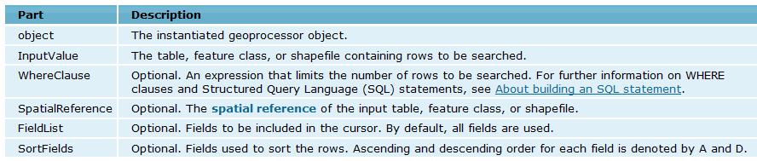
Cursor Tips
Use where clause to limit records - Same as using a definition query on a layer
Delete row and cursor objects to remove data locks
  gp.SearchCursor(InputValue As String, {WhereClause} As String, {SpatialReference} As Object, {FieldList} As String, {SortFields} As String) As Object
  http://webhelp.esri.com/arcgisdesktop/9.3/index.cfm?TopicName=SearchCursor_method
UC 2008 Tech Sessions

Slide 21
Reading Feature Geometry
Need coordinate information in a different coordinate system?
Features may be projected on-the-fly using the Spatial Reference parameter
  # Create a SR object from a projection file
  SR = gp.CreateObject(“spatialreference”)
  SR.CreateFromFile(”c:/NAD 1983 UTM Zone 10N.prj”)
  # Create search cursor, using GCS spatial reference
  rows = gp.SearchCursor("D:/data.mdb/roads","", SR)
  row = rows.Next()
UC 2008 Tech Sessions

Slide 22
Writing Feature Geometry
# Open an insert cursor for the feature class
cur = gp.InsertCursor(fc)
# Create array and point objects
lineArray = gp.CreateObject("Array")
pnt = gp.CreateObject("Point")
# Add two points to the array
pnt.X, pnt.Y = 358331, 5273193
lineArray.Add(pnt)
pnt.X, pnt.Y = 358337, 5272830
lineArray.Add(pnt)
# Create a new row, or feature, in the feature class
feat = cur.NewRow()
# Set the geometry of the new feature to the array of points
feat.Shape = lineArray
# Insert the feature
cur.InsertRow(feat)
UC 2008 Tech Sessions

Slide 23
Cursor Tips
The validity of the geometry is checked before it is added
  Problems such as invalid ring order are corrected automatically
  Uses the same process used by the Repair Geometry tool
Writing features requires a schema lock on the data
  Use the TestSchemaLock method to check
UC 2008 Tech Sessions

Slide 24
Section 3:
Objects as parameter value
UC 2008 Tech Sessions

Slide 25
Using Objects to Set Parameters
Most tool parameters are easy to define with a string or a number
  Such as a data path or buffer distance
Other parameters are not easy to define with a string
  Such as a spatial reference or field mapping
Geoprocessing objects can be used to set these parameters
Many ways to create geoprocessing objects
  The CreateObject method
  The Describe object, has properties that return Objects
UC 2008 Tech Sessions

Slide 26
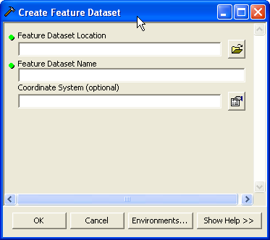
Tools and Parameters
A geoprocessing tool has a collection of parameter values
Parameters tell the tool what to do
UC 2008 Tech Sessions

Slide 27
Using Objects to Set Parameters
Use the SpatialReference object as a parameter value
import arcgisscripting
gp = arcgisscripting.create(9.3)
# Describe a dataset with a specific Spatial Reference
desc = gp.Describe("D:/St_johns/city.mdb/city_boundary")
# Create the FDS using the describe object's SR Object
gp.CreateFeatureDataset("D:/St_johns/city.mdb“,"NewFDS",
desc.SpatialReference)
UC 2008 Tech Sessions

Slide 28
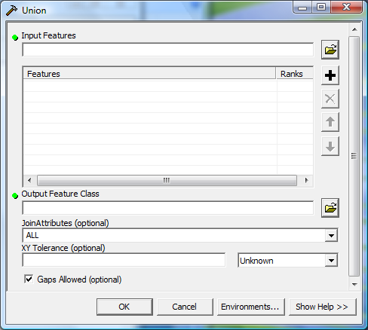
UC 2008 Tech Sessions

Slide 29
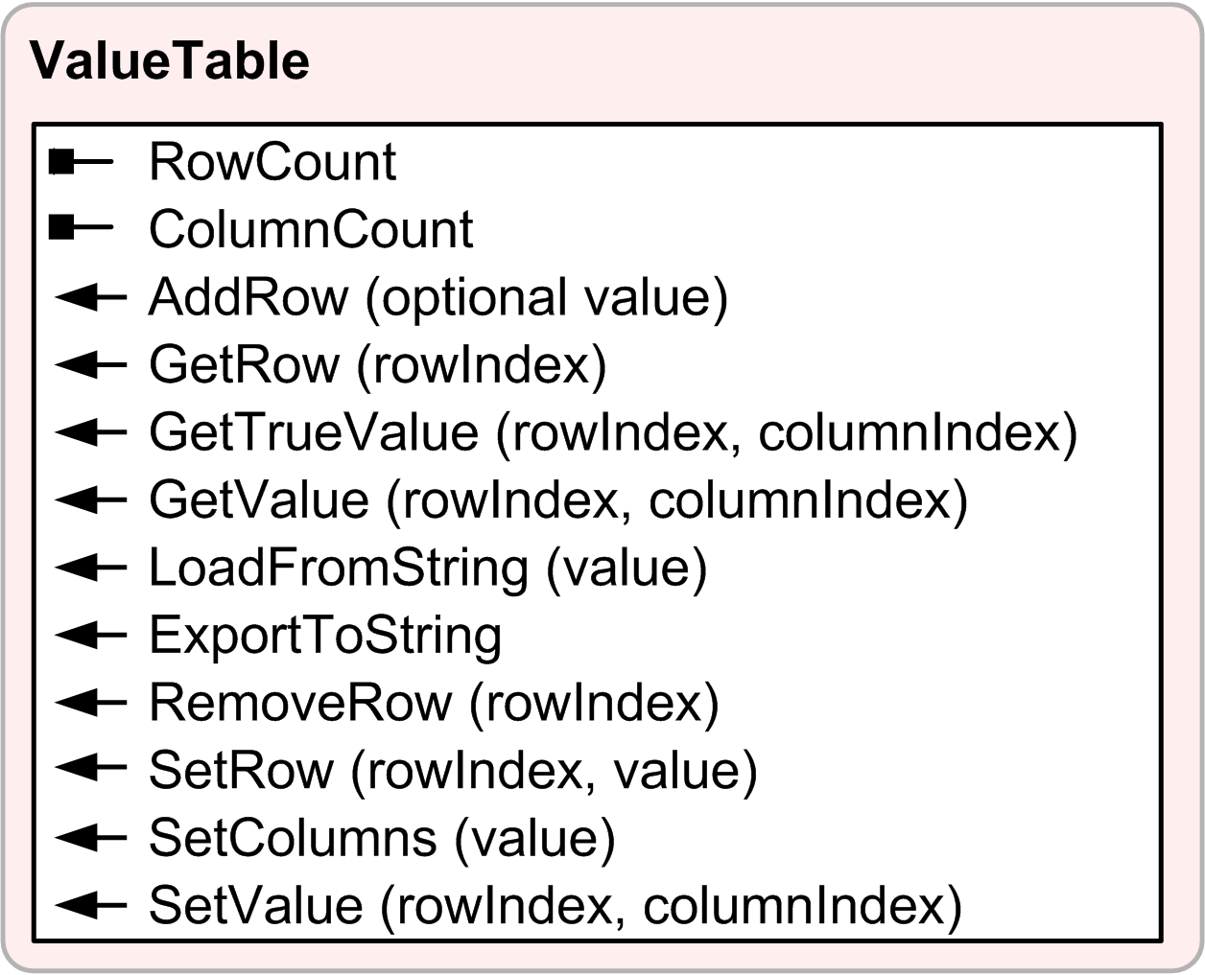
Using Objects to Set Parameters
Some parameters accept multiple values (Multivalue)
Multivalue parameters may be expressed in two ways:
  As a string ("value1;value2;value3")
  As a Value Table
Use LoadFromString method to
load a multivalue string
Use ExportToString to create an
output argument value
  Useful for script tools
UC 2008 Tech Sessions

Slide 30
Using Objects to Set Parameters
Overlay tools, such as Union use Value Tables with multiple columns
  Difficult to parse multi-value string when more than one column is used
import arcgisscripting
gp = arcgisscripting.create(9.3)
# Create a value table with 2 columns
vt = gp.createobject('valuetable', 2)
# Add 3 feature classes with ranks to the value table
vt.addrow("c:/base/counties.shp 1")
vt.addrow("c:/base/parcels.shp 1")
vt.addrow("'c:/base/state boundary.shp' 2")
# Run Union using the value table as input
gp.union(vt, "c:/output/landinfo.shp")
UC 2008 Tech Sessions

Slide 31
Demo 2:
Objects as parameter value
UC 2008 Tech Sessions

Slide 32
Python code from demo 2
# pertinent code of demo 2
shps = gp.listfeatureclasses()
for shp in shps:
desc = gp.describe(shp)
if desc.spatialreference.name == "Unknown":
gp.DefineProjection(shp, sr)
print "Set coordinate system for " + shp
else:
print shp + " already has a Coordinate System defined“
UC 2008 Tech Sessions

Slide 33
Section 4:
Error Handling
UC 2008 Tech Sessions

Slide 34
Error Handling
Syntax errors
  Detected when compiled
Execution errors
  Add error handling routines to catch errors
  Tool error messages can be retrieved from the geoprocessor or the traceback object
Errors you raise (or assert) yourself
  Use Raise and Assert statements to trigger specific exceptions
  Especially useful when using tools and native methods together
  Provides more meaningful context for messages
UC 2008 Tech Sessions

Slide 35
Error Handling
import arcgisscripting
gp = arcgisscripting.create(9.3)
# Get input and output feature classes
fc = gp.GetParameterAsText(0)
outfc = gp.GetParameterAsText(1)
try:
# If the input has point feature raise an error
if gp.Describe(fc).ShapeType == "Point":
raise Exception, "Feature Class should not be point"
else:
gp.FeatureToPoint(fc, outfc)
# Geoprocessing Errors will be caught here
except arcgisscripting.ExecuteError:
print gp.GetMessages(2)
# Other errors will get caught here
except Exception, ErrorDesc:
print ErrorDesc.message
UC 2008 Tech Sessions

Slide 36
Error Handling
Use the traceback module to get Python errors
Tutorial on python’s error handling can be found here http://docs.python.org/tutorial/errors.html
except:
import traceback, sys
# get the traceback object
tb = sys.exc_info()[2]
# tbinfo contains the error’s line number and the code
tbinfo = traceback.format_tb(tb)[0]
print tbinfo # provides where the error occurred
print sys.exc_type # provides the type of error
print sys.exc_value # provides the error message
UC 2008 Tech Sessions

Slide 37
Section 5:
Working with Geoprocessing Services
UC 2008 Tech Sessions

Slide 38
What is a Geoprocessing Service?
A toolbox that has been published to an ArcGIS Server
  The toolbox may contain multiple tools
  Server tools can be any script or model tool created in ArcGIS Desktop
Geoprocessing services can be used by several clients
  Desktop, Engine, Explorer, Server web clients
UC 2008 Tech Sessions

Slide 39
Accessing Geoprocessing Services
A geoprocessing service can be thought of as a remote toolbox
  Contain tools
  Can be added to your script with the AddToolbox method
  Run it the same as any other gp tool… almost
gp.AddToolbox("http://flame7/arcgis/services;GP/SurfaceModels")
gp.AddToolbox(“flame7;GP/SurfaceModels")
Service URL
Folder
GP Service
Local Host Name
UC 2008 Tech Sessions

Slide 40
Working with Geoprocessing Services
There are two types of geoprocessing services
  Synchronous – Must wait for server to complete the process
  Asynchronous – Free to complete other tasks while server executes
Input to a geoprocessing service can be:
  Record set
  Feature set
  Raster dataset
  String, Double, Long, Date, File, Linear Unit, Boolean
Feature sets and record sets are scripting objects
  Lightweight representations of feature classes and tables
  To use as input, create an empty object, and load data in
  http://webhelp.esri.com/arcgisdesktop/9.3/index.cfm?TopicName=Input_and_output_data_types
UC 2008 Tech Sessions

Slide 41
Demo 3: Geoprocessing Services
UC 2008 Tech Sessions

Slide 42
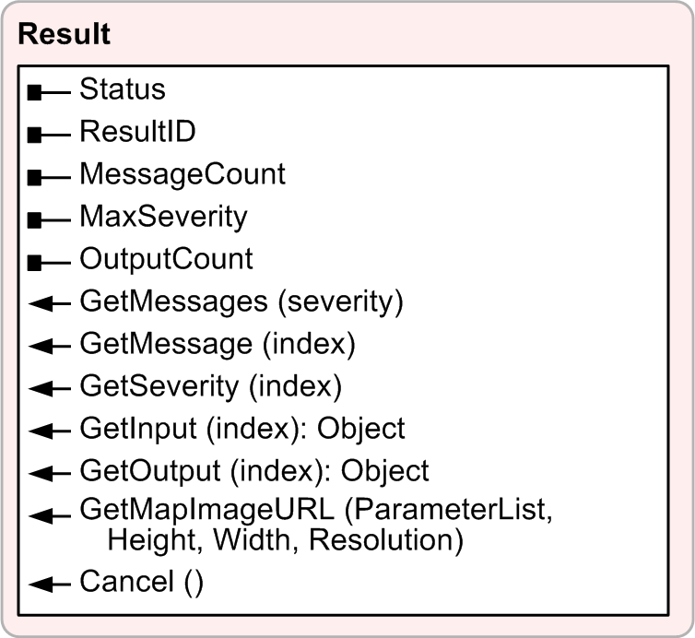
Working with Geoprocessing Services
9.3 all tools/services return results
http://webhelp.esri.com/arcgisdesktop/9.3/index.cfm?TopicName=Getting_results_from_a_geoprocessing_tool
The result object is how get status and you interact with the service
The GetOutput method retrieves data from the server
The GetMapImageURL method retrieves an output’s map service as an image
UC 2008 Tech Sessions

Slide 43
Accessing a Result’s Output Data
import arcgisscripting
import time
gp = arcgisscripting.create(9.3)
gp.AddToolbox("http://flame7/arcgis/services;GP/BufferTasks")
inFeatSet = gp.CreateObject("featureset")
inFeatSet.Load("C:/base/towers.shp")
results = gp.BufferPoints(inFeatSet, "5 feet")
# Service is asynchronous. Wait until the job has completed
while results.Status < 4:
time.sleep(0.2)
# Get an output Feature Set back and save locally
outFeatSet = result.GetOutput(0)
gp.CopyFeatures(outFeatSet,"C:/temp/base.gdb/towers_buffer")
UC 2008 Tech Sessions

Slide 44
Accessing a Result’s Output
Output feature data is returned as a feature set, tabular data as a record set
  Feature sets and record sets can be saved to disk, or used as input to other tools
Raster data is returned as a GeoTIFF
The ResultID property can be stored and used to retrieve the result later
resultID = result.ResultID
# Retrieve a result object using a ResultID
BuffResult = gp.CreateObject("Result",
”BufferPoints ” + resultID)
UC 2008 Tech Sessions

Slide 45
Help Resources
Geoprocessing references
  Scripting / Tool documentation
    http://webhelp.esri.com/arcgisdesktop/9.3
  Geoprocessing Resource Center
    http://resources.esri.com/geoprocessing
Python References
  Books
    Core Python by Wesley J. Chun
    Learning Python by Mark Lutz
    Dive Into Python by Mark Pilgrim - Free
  Python Organization
    http://www.python.org
UC 2008 Tech Sessions

Slide 46
Thank you
…please don’t forget to fill out an evaluation form!
UC 2008 Tech Sessions

